Slide 1
AFFECTIVE COMPUTING
Kongu Engineering College
Department of CSE
Aswin Siranjeevi
Eraja Ganapathy

Slide 2
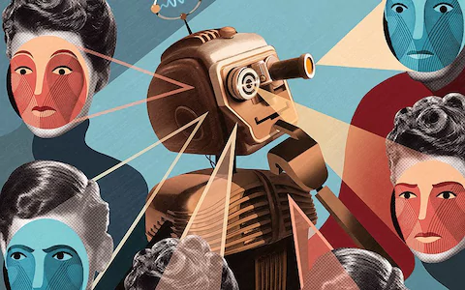
Introduction
Sometimes called artificial emotional intelligence, or emotion AI
Should interpret the emotional state
Giving an appropriate response to human emotions.

Slide 3
Emotion Models
Continuous Model
Facial expression of emotion as a feature vector in a face space
seen at different intensities
Categorical Model
Tuned to a specific emotion category
perceived as either happy or surprise but not something in between
Common Flaw
unable to identify multiple emotions

Slide 4
Task of Emotional Recognition
Emotional speech
Facial affect detection
Body gesture
Physiological monitoring
Visual aesthetics

Slide 5
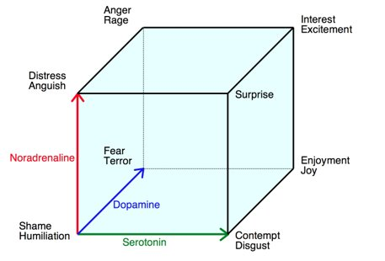
Emotion classification
Six Basic Emotions
Anger
Disgust
Fear
Happiness
Sadness
Surprise
Newly Included Emotions
Amusement
Contempt
Contentment
Embarrassment
Excitement
Guilt
Pride in achievement
Relief
Satisfaction
Sensory pleasure
Shame

Slide 6
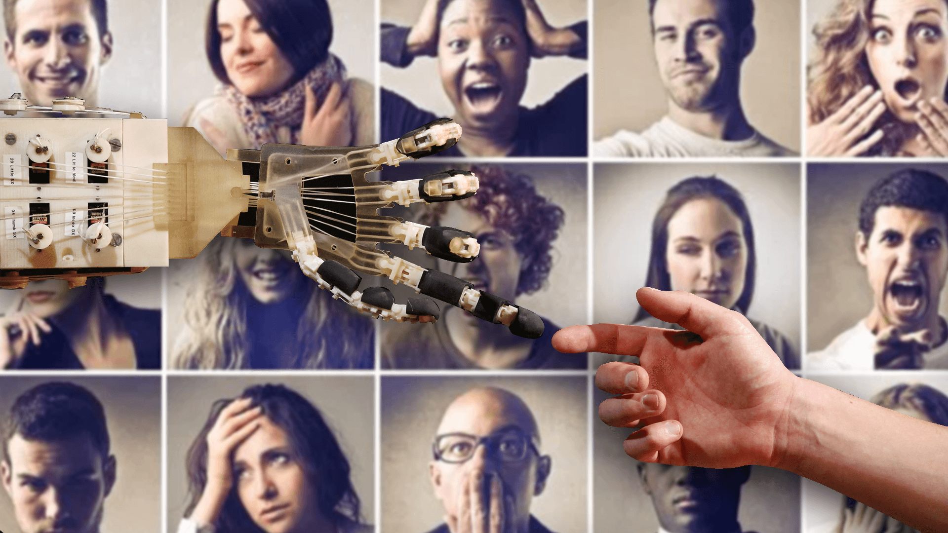
How computer empathize with us?
Uses facial expressions, micro-expressions, etc....
Then temperature of hands to register changes
in a user’s emotional state
Cameras and other sensors send the input data to deep learning algorithms

Slide 7
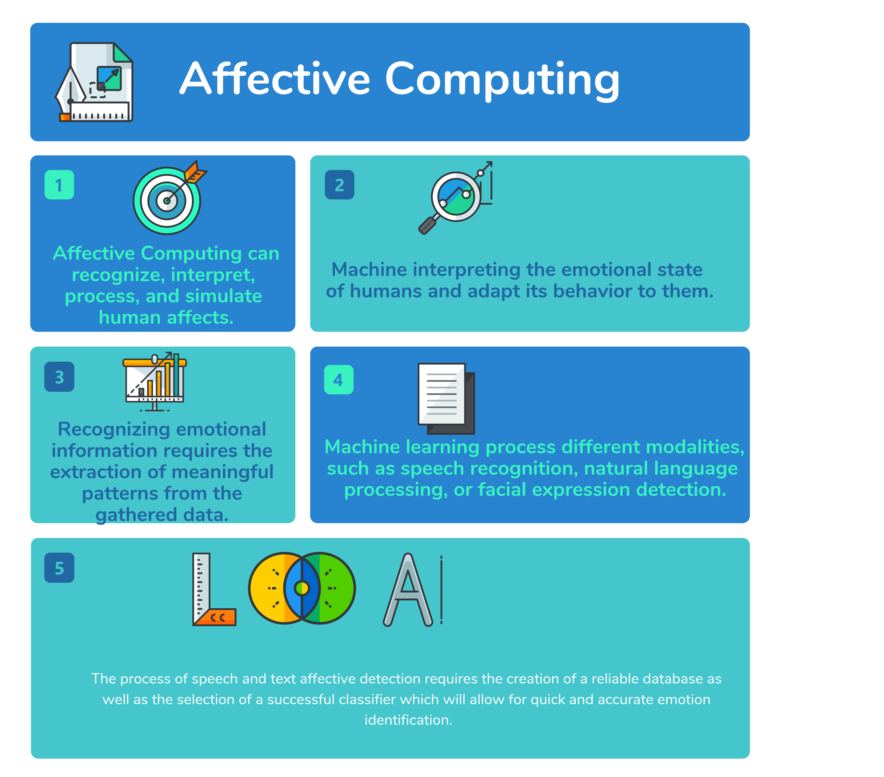
Affective Computing Process

Slide 8
Potential Applications
Education
Healthcare
Video games

Slide 9
Limitations
Recognizing emotions through physiological responses can be difficult.
Emotions can be acted out and even if the physiological responses might not be completely accurate
In a natural environment, the start time could be hard to detect
Physiological signals can also be affected by non-emotional
Our individual physiological responses are not identical
No currently known method to separate the emotional and non-emotional responses.

Slide 10
Conclusion
various emotion models
Collecting data, and converting existing data would be most urgent and significant issue
uses popular classification algorithm

Slide 11
THANK YOU

